Slide 1
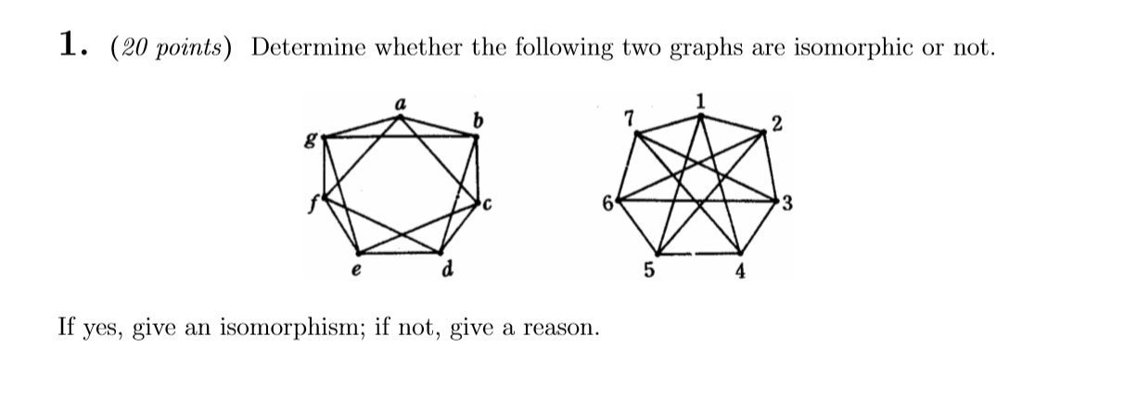

Slide 2
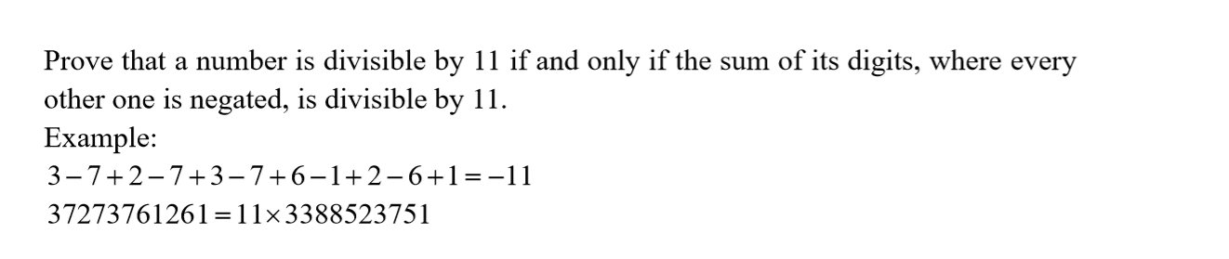

Slide 3
Question
Let a∈Z⁺, b∈Z⁺ be such that gcd(a,b) = 1. Prove that there exists n∈Z⁺ such that a^{n} ≡ 1 (mod b).

